Slide 1
March 17, 2022
Visit us at equityininfrastructure.org
March 17, 2022

Slide 2
EIP Background
EIP was co-founded in 2021 by Phil Washington, CEO of Denver International Airport, and John Porcari, former Deputy Secretary at the U.S. Department of Transportation in anticipation of what became the Infrastructure Investment and Jobs Act, along with state and regional infrastructure investment.
Our mission is to establish the circumstances to create generational wealth for enterprises in communities previously left behind by increasing their participation in the infrastructure realm of the economy.
We are building a coalition of infrastructure agencies pledging to take action to support President Biden’s goal to have more diverse firms fulfill federal, state, and local contracts spanning multiple modes of transportation and types of infrastructure.
We have partnered with five public agencies named “first mover agencies” who have pledged to increase their diversity requirements for procurement.

Slide 3
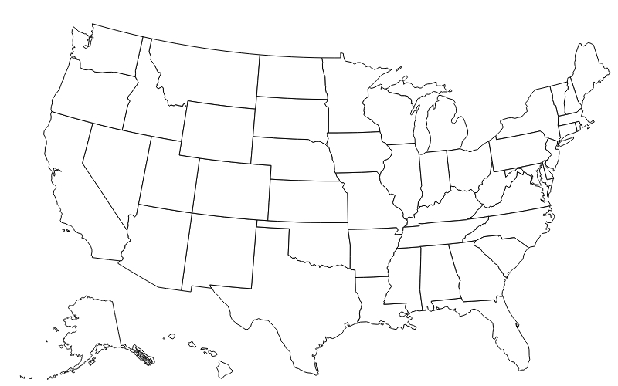
First Mover Agencies

Slide 4
First Mover Capital Programs
$2.3B capital improvement program
$17B+ in total capital projects over the next decade
$3.2B capital improvement program
$3.5B capital improvement program
$3.5B capital improvement program
$5.2B capital improvement program

Slide 5
EIP Pledge
America is seizing a historic opportunity for generational investment in our infrastructure. We also have a historic opportunity to provide a pathway to create generational wealth and expand opportunities for sustainable jobs and careers for those historically left out.
As agencies representing diﬀerent modes of infrastructure and geographies across the country, we pledge to take new action to increase the ability of certified small and minority owned businesses to compete for contracts and subcontracts with the goal of expanding their participation in infrastructure work. For the purposes of this Pledge, this includes small businesses competing as Disadvantaged Business Enterprises (DBEs) for federally funded projects, and those competing for locally-funded projects as any category of historically underutilized businesses (HUBs). HUBs, by our definition, can include firms formally designated as DBEs, Minority and Women-Owned Business Enterprises (M/WBE), Small Business Enterprises (SBE), and it can include any other business classification used locally in the United States intended to boost the participation of otherwise underutilized firms, which can vary by state, region, and municipality. We will partner with the Federal government to ensure that funds from the bipartisan Infrastructure Investment and Jobs Act support expanded opportunities to create generational wealth for diverse entrepreneurs and workers, especially in underserved communities across America.
Starting from the baseline of our current actions and initiatives, by December 2025 we will work to expand contracting opportunities to increase the number, size and percentage of historically underutilized businesses growing to primes, joint ventures, or equity participants. We will do this by:
Increasing the number, size and proportion of contracting opportunities for HUBs, as defined above;
Increasing the number, size and proportion of contracting opportunities for HUBs as prime contractors;
Streamlining the administration of all above listed contracting to centralize certiﬁcation, improve payment time, and standardize transparent data collection;
Increasing the amount and type of appropriate ﬁnancing available to all above listed ﬁrms aiming to meet infrastructure contracts by working with private and public partners;
Expanding the number of signatories to this pledge.

Slide 6
Proposed EIP Pledge Commitments
DBE prime contracting. Inclusion of language regarding DBEs as joint ventures, primes, and/or equity participants.
Funding and financing for community wealth building
Administrative alignment. Simpler certification processes and more sophisticated databases to increase utilization of DBEs.
Administrative and certification alignment
Direct contracting by procuring agencies
Funding and Financing. Supporting deployment of capital in support of DBE wealth building.

Slide 7
Proposed EIP Pledge Commitments
DBE prime contracting. Inclusion of language regarding DBEs as joint ventures, primes, and/or equity participants.
Funding and financing for community wealth building
Administrative and certification alignment
Local Commitment
Federal Commitment
RFP and contract language that supports DBEs:
Joint ventures
Prime contractors
Equity participants
Core: DBE prime legal clearance pilot akin to local hire pilot (using existing authorities)
Stretch: TIFIA and Build America Bureau support for DBE equity participation
Direct contracting by procuring agencies

Slide 8
Proposed EIP Pledge Commitments
Administrative and certification alignment. Simpler certification processes and more sophisticated databases to increase utilization of DBEs.
Funding and financing for community wealth building
Administrative and certification alignment
Local Commitment
Federal Commitment
MOUs with other local agencies for central certification processes
Alignment with other local agencies’ procurement language
Core: Modal administration alignment of DBE requirements between modes
Stretch: Transparent federal DBE database and/or improved state reciprocity
Direct contracting by procuring agencies

Slide 9
Proposed EIP Pledge Commitments
Funding and Financing. Supporting deployment of capital in support of DBE wealth building.
Funding and financing for community wealth building
Administrative and certification alignment
Local Commitment
Federal Commitment
Improve DBE on-time payment performance
Contract financing programs
New forms of capital for small business
Core: Discretionary grants to include scoring related to equitable procurement
Direct contracting by procuring agencies

